Slide 1
MSA 8770 Text Analytics Mini Project II Anesia McCarthy Shreyashi Mukhopadhyay October 31, 2023

Slide 2
Text summarization using Sequence-to-Sequence Architecture with LSTMs

Slide 3

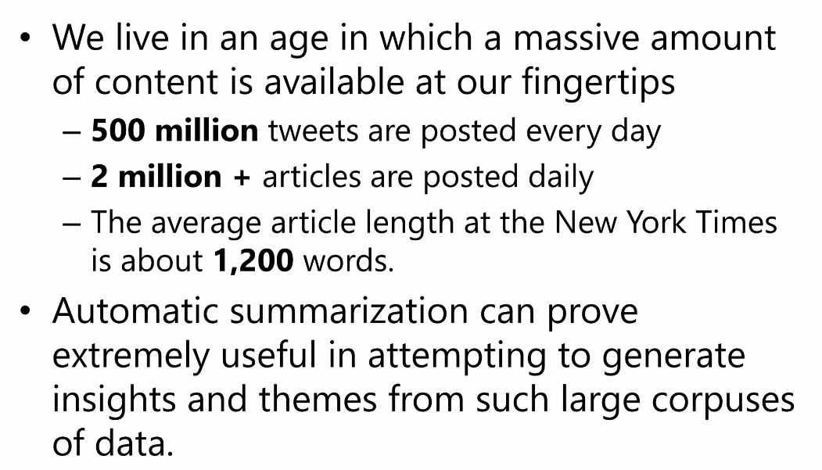
Introduction: Text Summarization

Slide 4
Limitations of Human Summarization
Biased
Subjective
Time consuming
Inefficient for large corpus
Expensive
Can miss out on important information
Prone to errors
Challenging to summarize from multiple documents

Slide 5
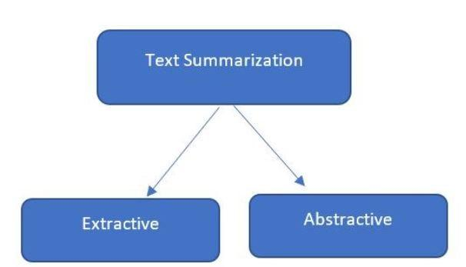
Text summarization methods
There are two different types of text summarization:
· Extractive Summarization
· Abstractive Summarization
Text Summarization Using Deep Learning | by Nibedita Das | Medium

Slide 6
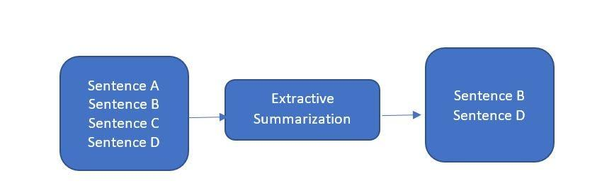
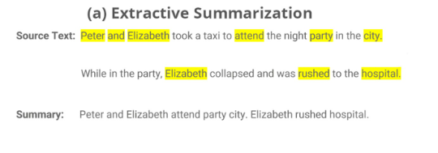
Extractive Summarization
In Extractive summarization, the important sentences or phrases from the original text is identified and extracted based on the sentence weights. Those extracted sentences would be the summary.

Slide 7
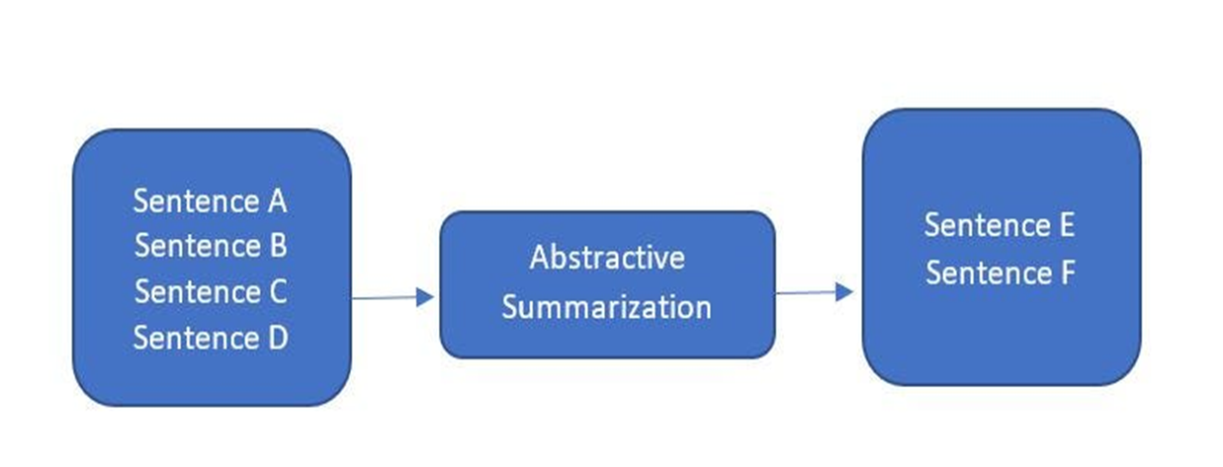
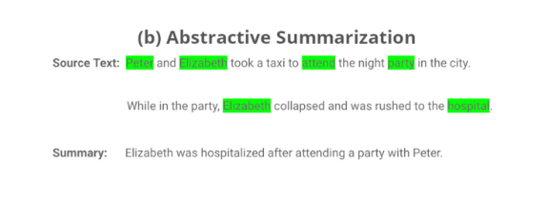
Abstractive Summarization
In abstractive summarization new sentences are generated as output. The sentences generated through abstractive summarization might different from what is present in the original text.

Slide 8

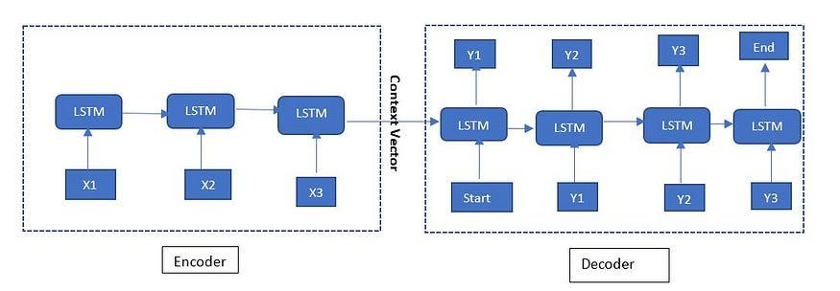


Sequence-to-Sequence (Seq2Seq) Model
Encoder: It accepts a single element of the input sequence at each time step and processes it. After processing, the information from that element is propagated forward.
Decoder: It takes information about the entire input sequence from the encoder and predicts an output at each time step.
We are using LSTMs (Long Short Term Memory) for both Encoder and Decoder.

Slide 9



Phases of the Encoder Decoder Model
There are two phases for building the Encoder-Decoder model for text summarization.
· Training phase
· Inference phase

Slide 10
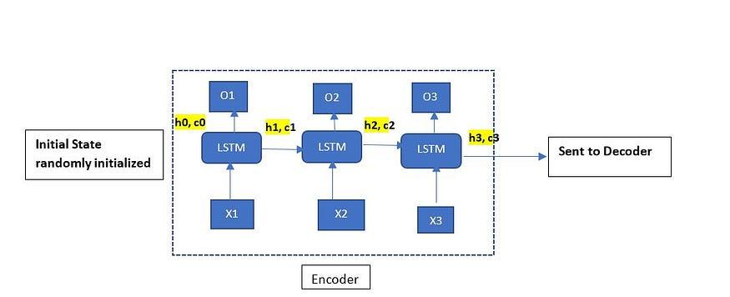
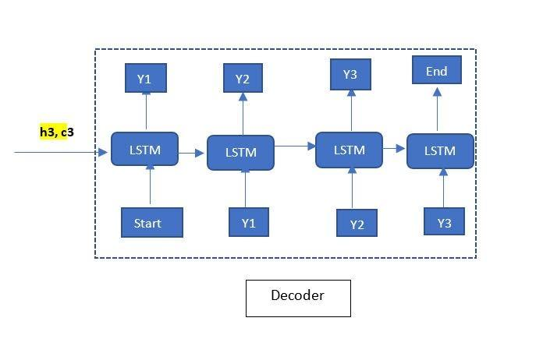
Training Phase Architecture
We will pass the long text into the Encoder. At each time step one word is fed into the encoder. LSTM present in encoder processes the input words and captures the context information at each time step. The context information from the last time step (hidden state — ht) is used to initialize the hidden state of Decoder. Cell state is represented by ct. Output of encoder is O1 to O3, which is not used for current use case.
Decoder reads the target text (summarized text) word by word and predicts next word in the target sequence. <start> and <end> are the special tokens which are added to the target sequence before feeding it into the decoder. <start> and <end> indicates starting and ending of a text sequence respectively.

Slide 11
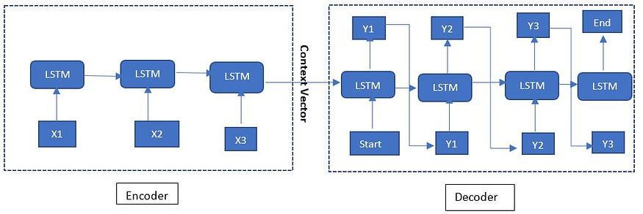
Inference Phase Architecture
Inference Phase:
Once training is done, the model is in testing phase with test data set for which target is not known.
Encode the input sequence
Pass the encoded input sequence to the Encoder
Pass the context vector from the Encoder to the Decoder hidden state
Enter <start> token as an input to the decoder
The output will be the probability for the next word. The word with the maximum probability will be selected
Enter the selected word as an input to the decoder in the next timestep and update the internal states with the current time step
Repeat steps 5–6 until we generate <end> token or reach the maximum length of the target sequence.

Slide 12
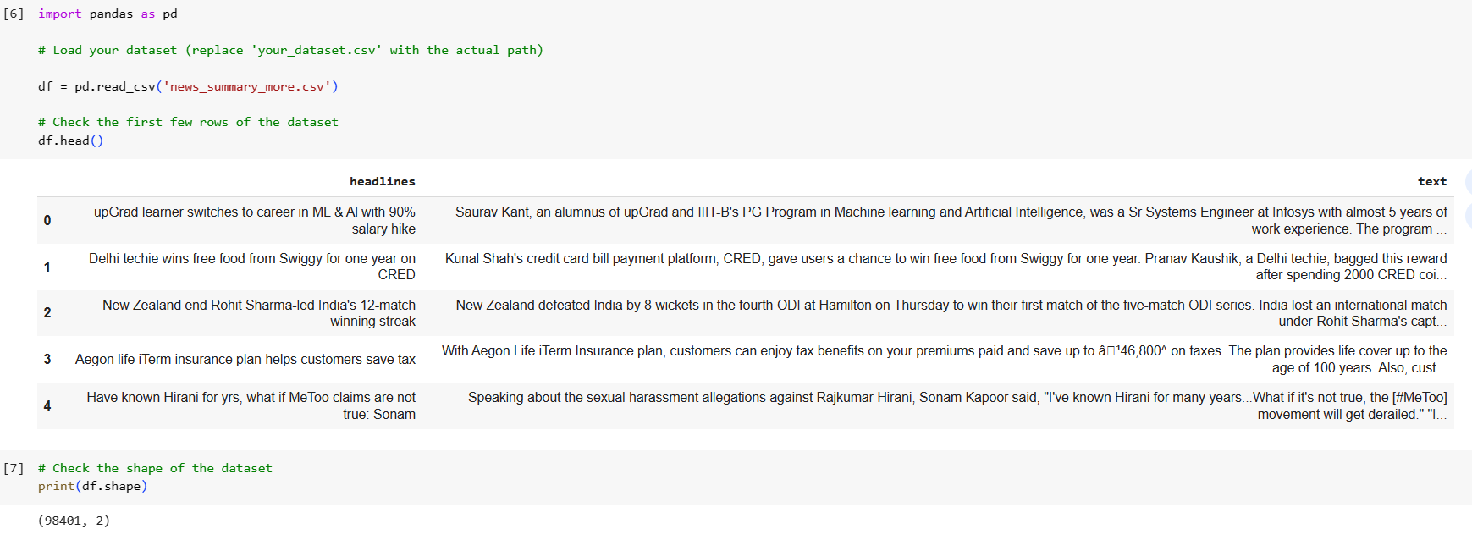
Data Description

Slide 13
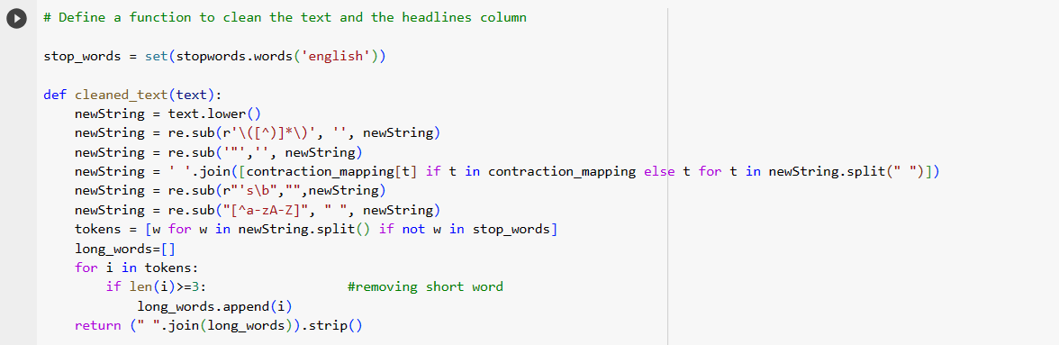
Apply Data Cleaning to Text and Headline data
Convert text to lower case
Remove punctuations & Numbers
Remove Contractions
Remove tokens less than size 3
Remove white spaces
Tokenize the data
Apply stop words
Join the tokens

Slide 14
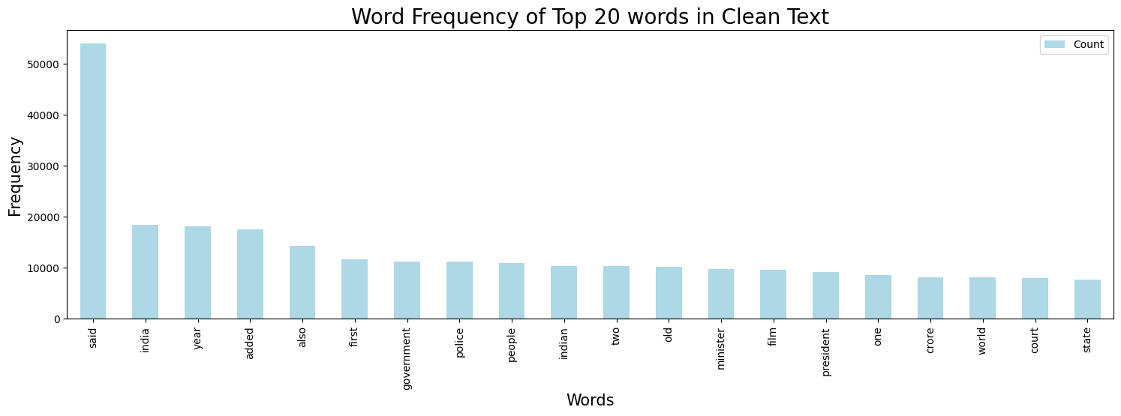
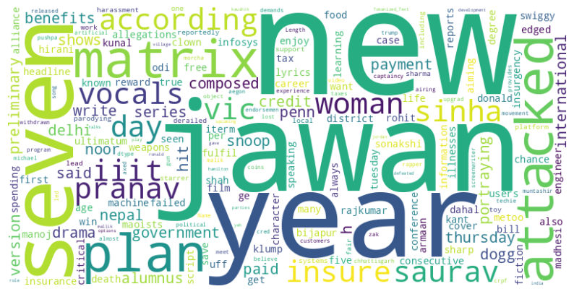
Visualize the cleaned Text Data

Slide 15
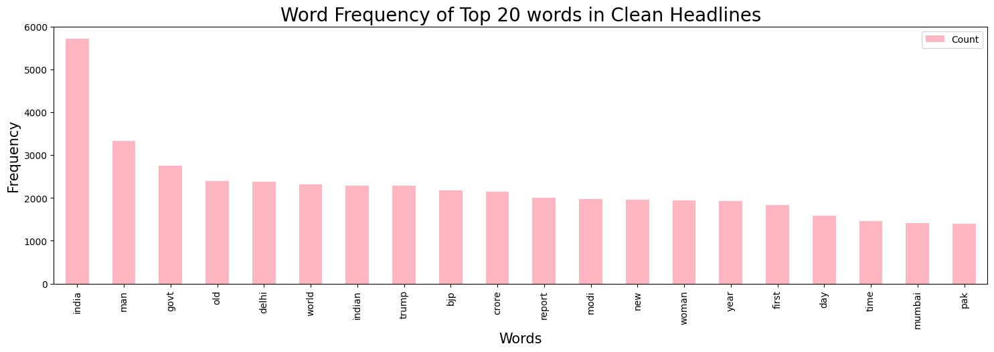
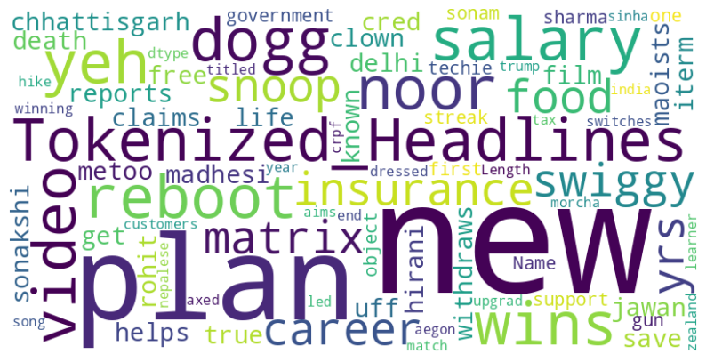
Visualize the cleaned Headlines Data

Slide 16
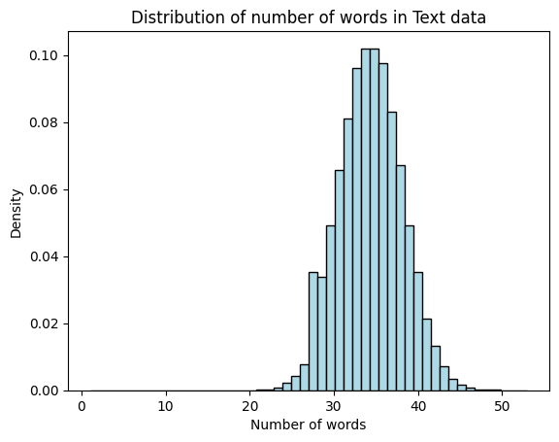
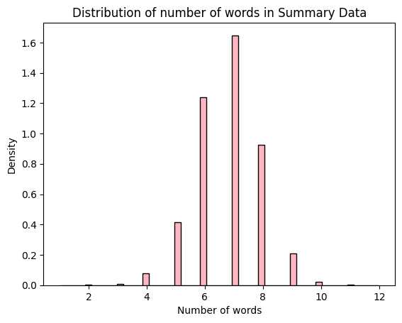
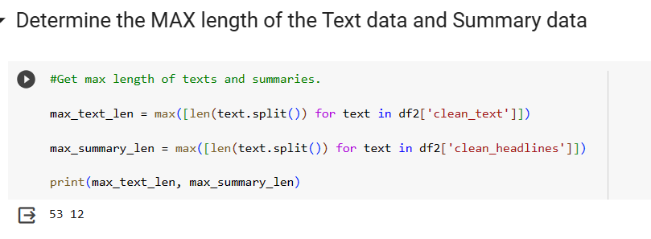
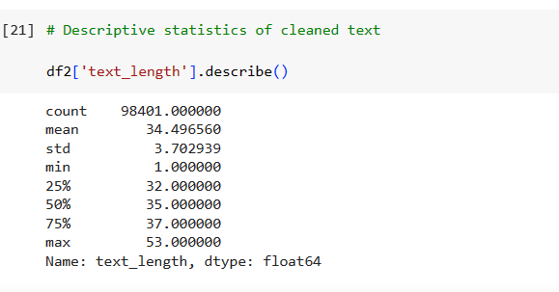
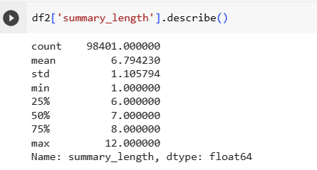
Word count distribution in Text and Headline Data

Slide 17
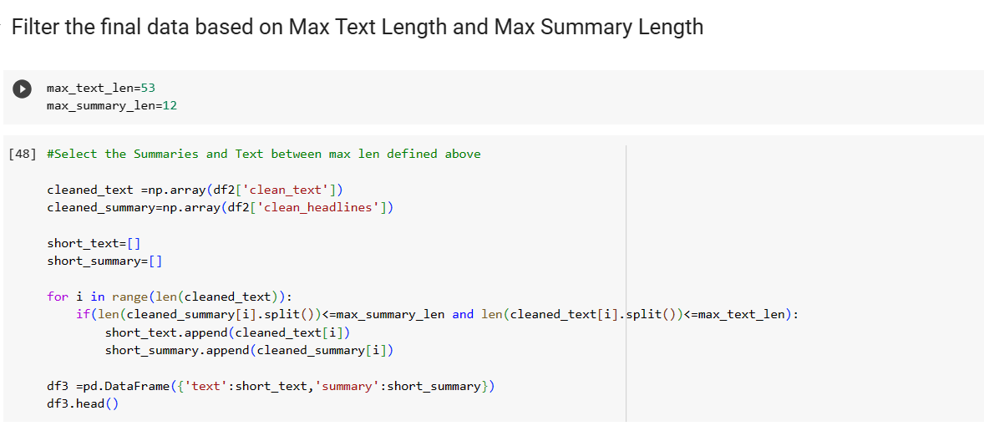
Filter the final data based on Max Length

Slide 18
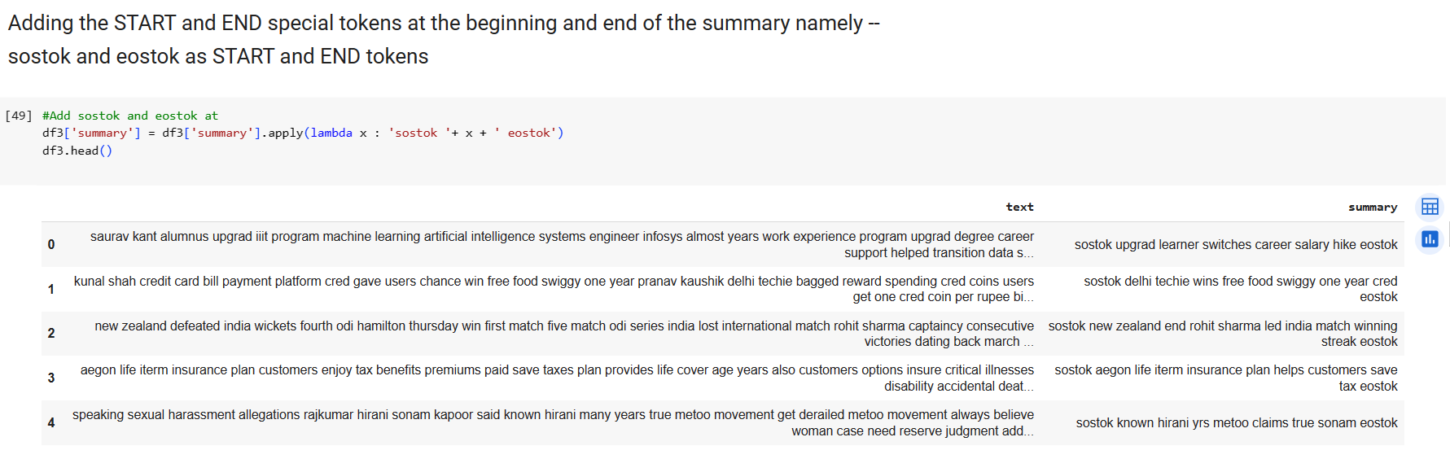
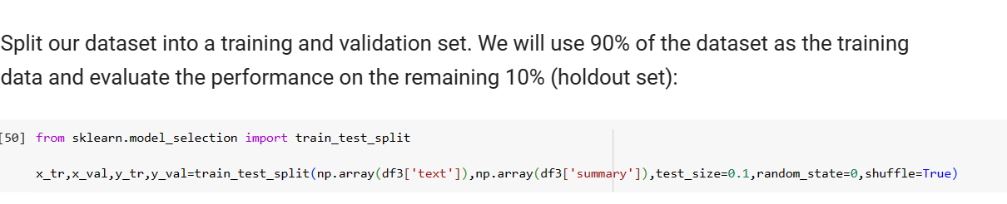
Add START and END tokens & Split the dataset

Slide 19
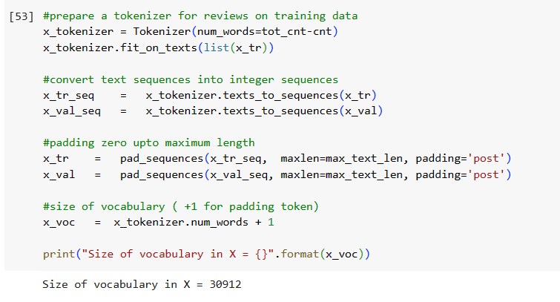
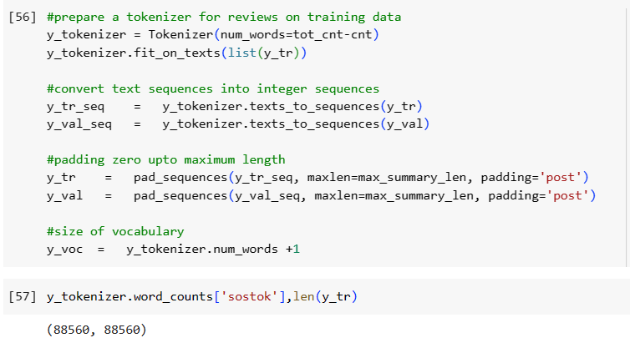
Tokenize the Training and Validation data

Slide 20
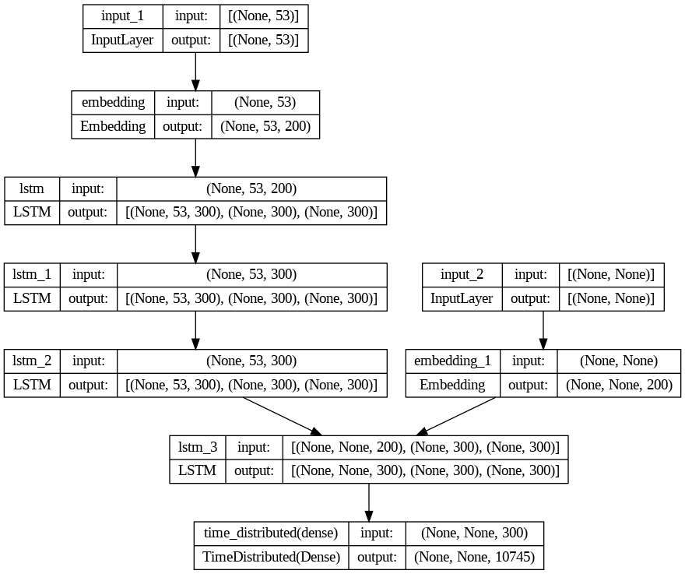
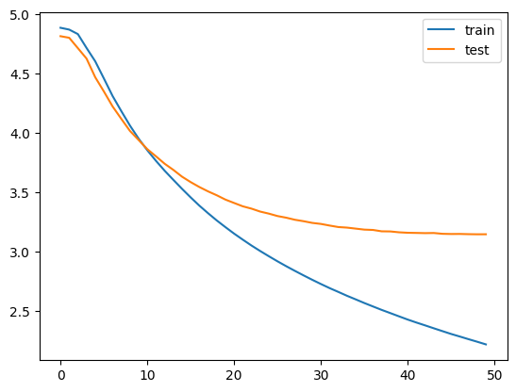
Model Fitting
Model Loss decreases over 50 epochs from 4.88 to 2.21

Slide 21
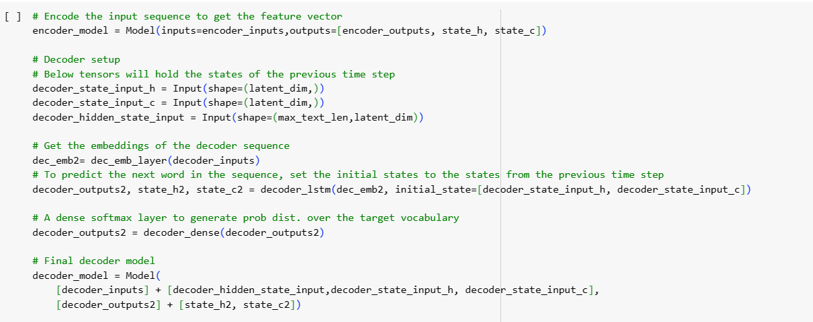
Inference -- Set up inference for the encoder and decoder

Slide 22
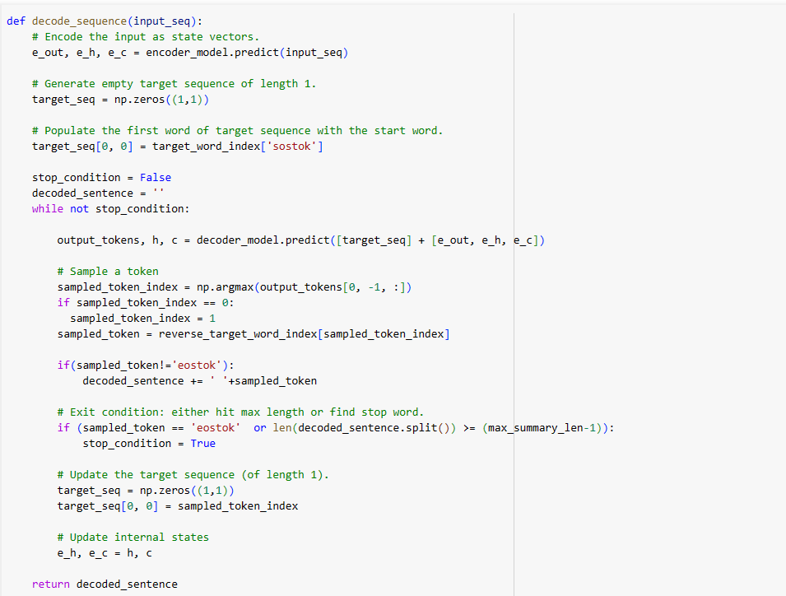
Implementation of the inference process

Slide 23
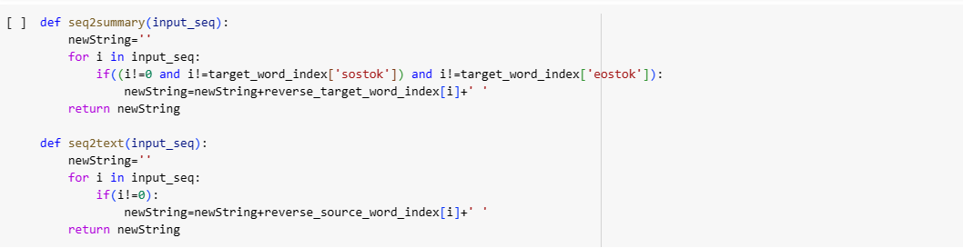
Convert an integer sequence to a word sequence for summary as well as Text

Slide 24
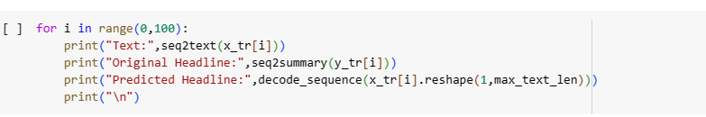
Summaries generated by the model
Text: president donald trump level trust russia deteriorated russian president vladimir putin said comes launched missile strike russian ally syria response chemical attack russia said strike amounted aggression sovereign nation violation international law
Original Headline: trust russia trump putin
Predicted Headline: trump russia calls putin russia

Slide 25
Summaries generated by the model:
Text: indian american billionaire founder therapeutics john kapoor resigned company board days arrested charges bribery accused bribing doctors prescribe firm opioid painkillers also resigned chairman director generic drugmaker
Original Headline: indian american billionaire resigns bribe case
Predicted Headline: billionaire founder resigns billionaire
Text: north korea said weapons directed south korea russia china official dialogue held first time two years north south korea agreed hold military talks avoid accidental conflict north korea also announced participation winter olympics south korea next month.
Original Headline: korea says weapons directed korea
Predicted Headline: korea korea vows hold nukes

Slide 26
Limitations of the Model: Future Work
We would like to add an attention layer to the LSTM model.
We would like to add additional Bi-directional LSTMS and GRU layers to see a better performance.
Reduce model training time by reducing the no. of Epochs to see if we get same results.
Calculate the BLEU Score to compare models.

Slide 27

Questions?

Slide 28
Thank you!

